Slide 1



Mentor Leadership Programme
Day 2
22nd November 2019
WWW.YORKSJ.AC.UK

Slide 2


Practicalities
All breaks and lunch will be De Grey foyer
Fountains Lecture Theatre at 9.15am and 3.15pm
All other sessions will be in De Grey
www.yorksj.ac.uk

Slide 3


Sessions and rooms
1. Developing a coaching culture within your team: DG019
2. What is your mentoring style?: DG123
3. How coaching principles can support transformational (and difficult) conversations: DG125
4. How to recognise and address mental health issues: De Grey 223
www.yorksj.ac.uk

Slide 4
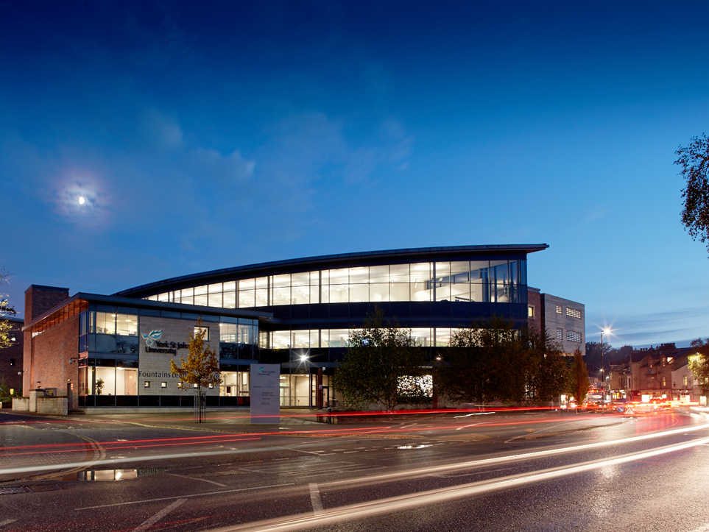
Expectations of the 3 day programme
to challenge professional and personal thinking
not a 'traditional' CPD event
about on-going reflexivity and ownership
beyond initial mentor training and technicalities

Slide 5
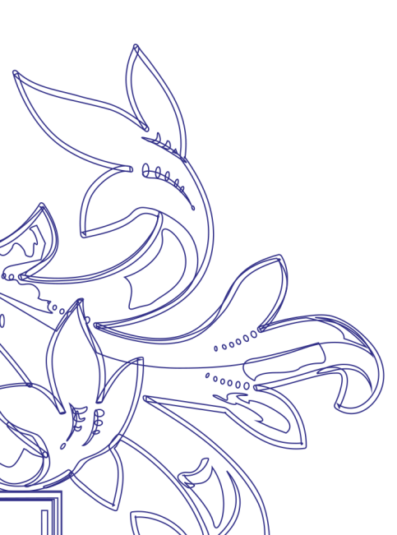


Your feedback from Day 1
"Great workshops and keynotes. What did I miss??"
"Different views of coaching and mentoring"
"Networking and meeting new people"
"Information and time to reflect"
The Header Here
Main points here
www.yorksj.ac.uk

Slide 6


Your feedback from Day 1
More time for discussion
Scenarios and application to own context
Modelling of types of mentoring
Copies of resources
Biscuits
www.yorksj.ac.uk

Slide 7
Day 2
Reflection breaks
Longer sessions (not workshops) with modelling and time for reflection and application to you, your setting and role
Experienced mentors and coaches leading each session
Networking: task today to identify a buddy. Between now and Day 3 (31st March), agree to meet up, discuss your mentoring, observe each other mentoring, get feedback on each other's mentoring...

Slide 8
Day 2
Reflection breaks
Longer sessions (not workshops) with modelling and time for reflection and application to you, your setting and role
Experienced mentors and coaches leading each session
Networking: task today to identify a buddy. Between now and Day 3 (31st March), agree to meet up, discuss your mentoring, observe each other mentoring, get feedback on each other's mentoring...
www.yorksj.ac.uk

Slide 9
Development of themes
Day 1 (knowing yourself)
Non-judgemental communication
DISC profiling
Art of positive thinking
Values, goals and coaching priorities
NLP for self awareness
Day 2 (mentor strategies)
Transformational conversations
What type of mentor are you?/Building a coaching culture
Mental health and well-being/What type of mentor are you?
Building a coaching culture
Transformational conversations/Mental health and well-being
www.yorksj.ac.uk

Slide 10

Framework for Day 3: Practising Mentoring
Reflect upon your own practice and development as mentor and coach
Utilise case studies of your practice to develop reflexivity
Apply skills and techniques alongside coaches, mentors and mentees
Review and set targets for personal and professional development
www.yorksj.ac.uk

Slide 11
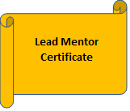
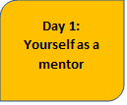
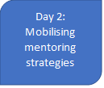
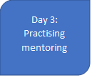
Lead Mentor
Attended all three days
Able to deliver initial mentor training for new mentors
Contribute to the second cohort of the Mentor Leadership Programme
www.yorksj.ac.uk

Slide 12
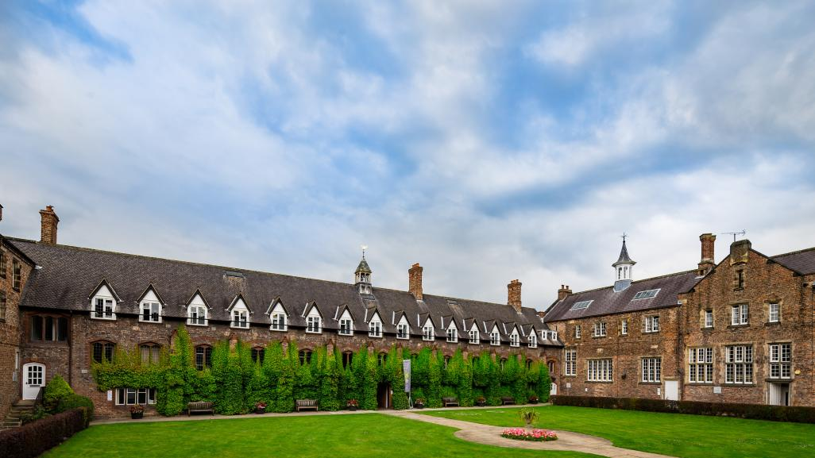
Plenary and close
Register for Day 3
Exchange contact details with your 'buddy'
Please leave your completed feedback form at the front
www.yorksj.ac.uk

Slide 13
Optional Year 2 of the programme
Portfolio of evidence to demonstrate leadership in mentoring and coaching
Reflective writing on your personal and professional development
'Master/Expert Mentor' status
Recognition of employing school as a Centre of Mentoring Excellence
www.yorksj.ac.uk

Slide 14
Programme Aims
To reconceptualise the process of mentoring and acknowledge the complexities arising in the relationship between the mentor and mentee
To place the self as mentor in a reflexive capacity so that the mentoring process is both effective and flexible
To create a network of established mentors from a range of schools and settings in order to share and learn from practice
www.yorksj.ac.uk

